Slide 1
Simulation
Computational Social Science
Lecture 8

Slide 2
Overview
Models represent key features of a social theory
Simulations are models of a process
Explicit representation of mechanisms
Two common approaches
Microsimulation: individuals without interaction
Agent-based modelling: individuals with interaction
Simulation output combines theory with data

Slide 3

What is a Model?

Slide 4
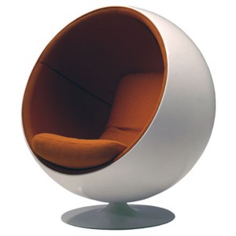
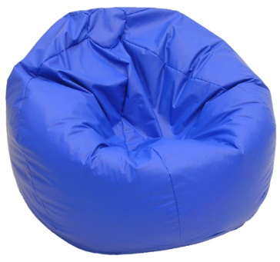
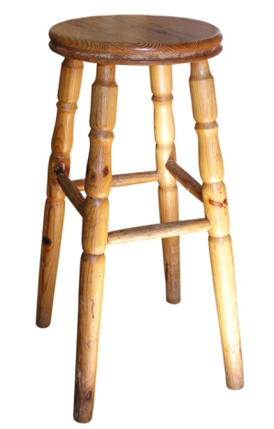

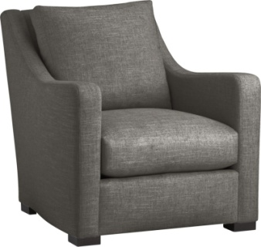


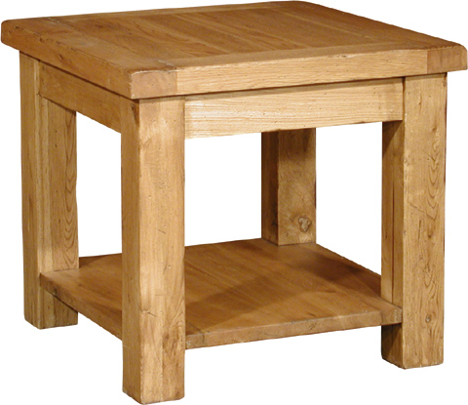
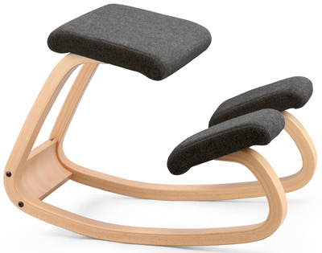
Let’s start with chairs (or close approximations)

Slide 5
What makes an object a chair?
Clearly chairs (hopefully)
Why (what do they have in common)?
Surface to sit on
Legs
Back rest
Also decided certain things don’t matter
Style of legs
Presence of arms
Construction materials
Colour
Typical location (dining room, living room, office)

Slide 6
What makes an object a chair?
Are these all chairs?
Why or why not?
Anyone think that one of these is not a chair?
The kneeling chair does not have a back rest
Maybe back rest not important

Slide 7
What makes an object a chair?
What about these?
Why or why not?
Either of these not a chair?
Starting to use different words
‘chair’ insufficient
Subclasses of chairs or not chairs?
Perhaps inconsistencies?
Why is stool different from kneeling chair?

Slide 8
What makes an object a chair?
Table, not a chair
Could be sat on, so why isn’t it a chair?
or at least a stool?

Slide 9
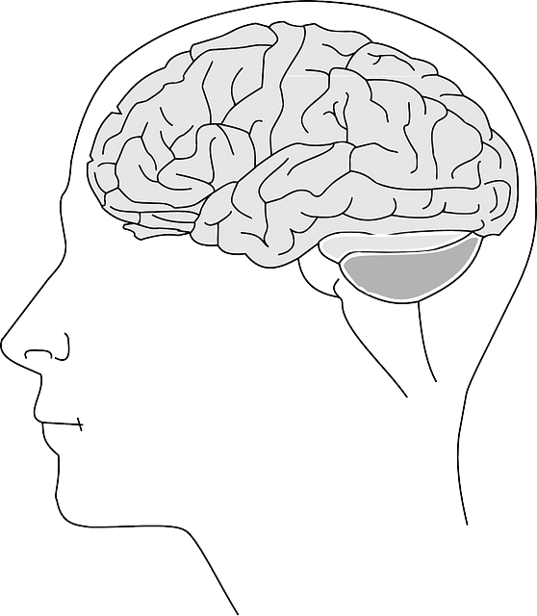



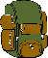

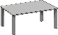


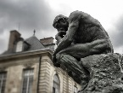
How to decide whether a chair?

Slide 10
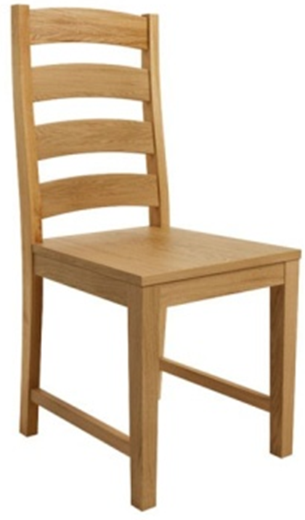
Why are we talking about chairs?
Definition of a chair is a (text) model of a chair
Setting up a particular way of thinking about what a model is
Captures the essence of something else
Setting up ideas about what a model can do
Explicit theory promotes discussion
Provides rules that classify cases not yet seen
Essence of a chair (approximately)
Surface to sit on
Legs
Intended to be used as a seat

Slide 11
What is a model?
Formal representation…
the model is constructed using a language, diagram or some other communication medium
external to the modeller, so allows discussion and interpretation
… of relevant features and relationships…
simplification that nevertheless captures the important features of the target system
…of some target system
there is some target object or system that the model is intended to represent
Definition adapted from Greenberger M, MA Crenson & BL Crissey (1976). Models in the Policy Process. New York: Russell Sage Foundation.

Slide 12
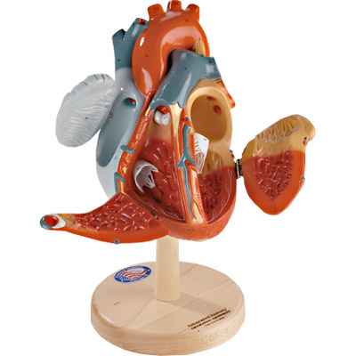
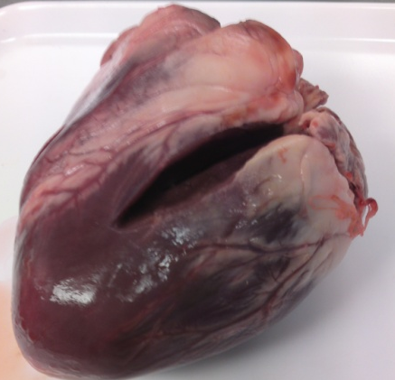
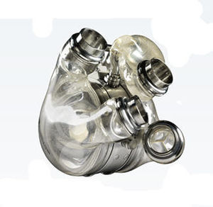
Relevant features?
Depends on purpose
eg human heart
Structure
Surgical practice
Pumping blood
NOT interchangeable
Physical
Behavioural
Functional

Slide 13

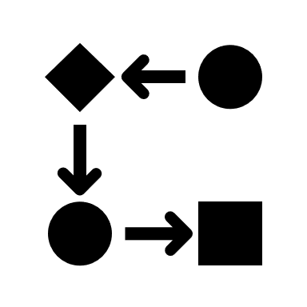
What is a simulation?
A simulation is a model of a process
What is a process?
Occurs through time
State of world changes
Series of actions / decisions and their consequences

Slide 14
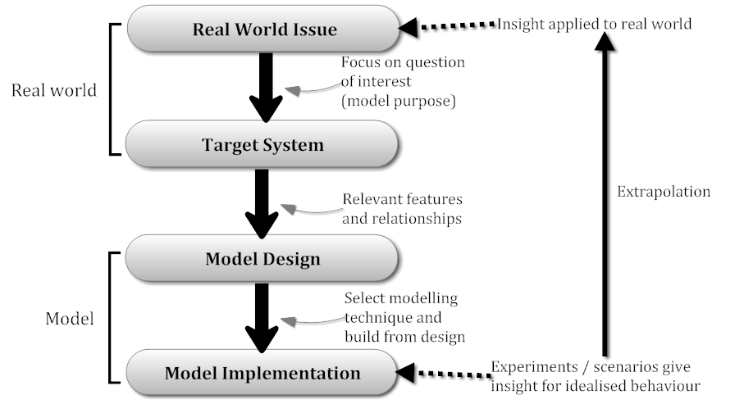
Why is a model useful?
Simplification helps us to understand, and to apply our knowledge

Slide 15
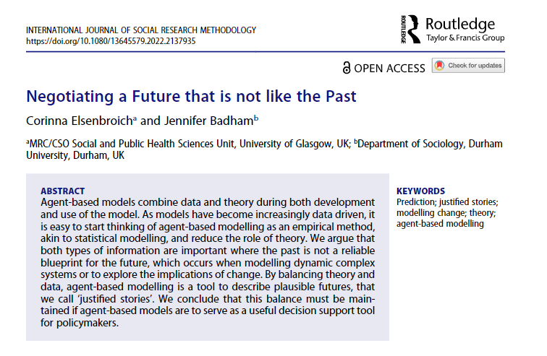
A good model combines theory with data (evidence)
Theory sets the model rules
Model is internally consistent
Generates stories, sequences of events
Data to calibrate and test the model
Model is externally coherent, consistent with what is known
Stories are therefore plausible, given knowledge
Justified stories can be scenarios that are not part of existing evidence base

Slide 16
Modelling a process, not modelling a dataset
Meaning of model for purposes of today
Theory
Mathematical model represents theory: data used to refine model (calibrate) or assess adequacy of theory
Statistical model represents data (or patterns in the data), which then may generate hypotheses or theory.
Machine learning doesn’t care about theory at all
Data

Slide 17
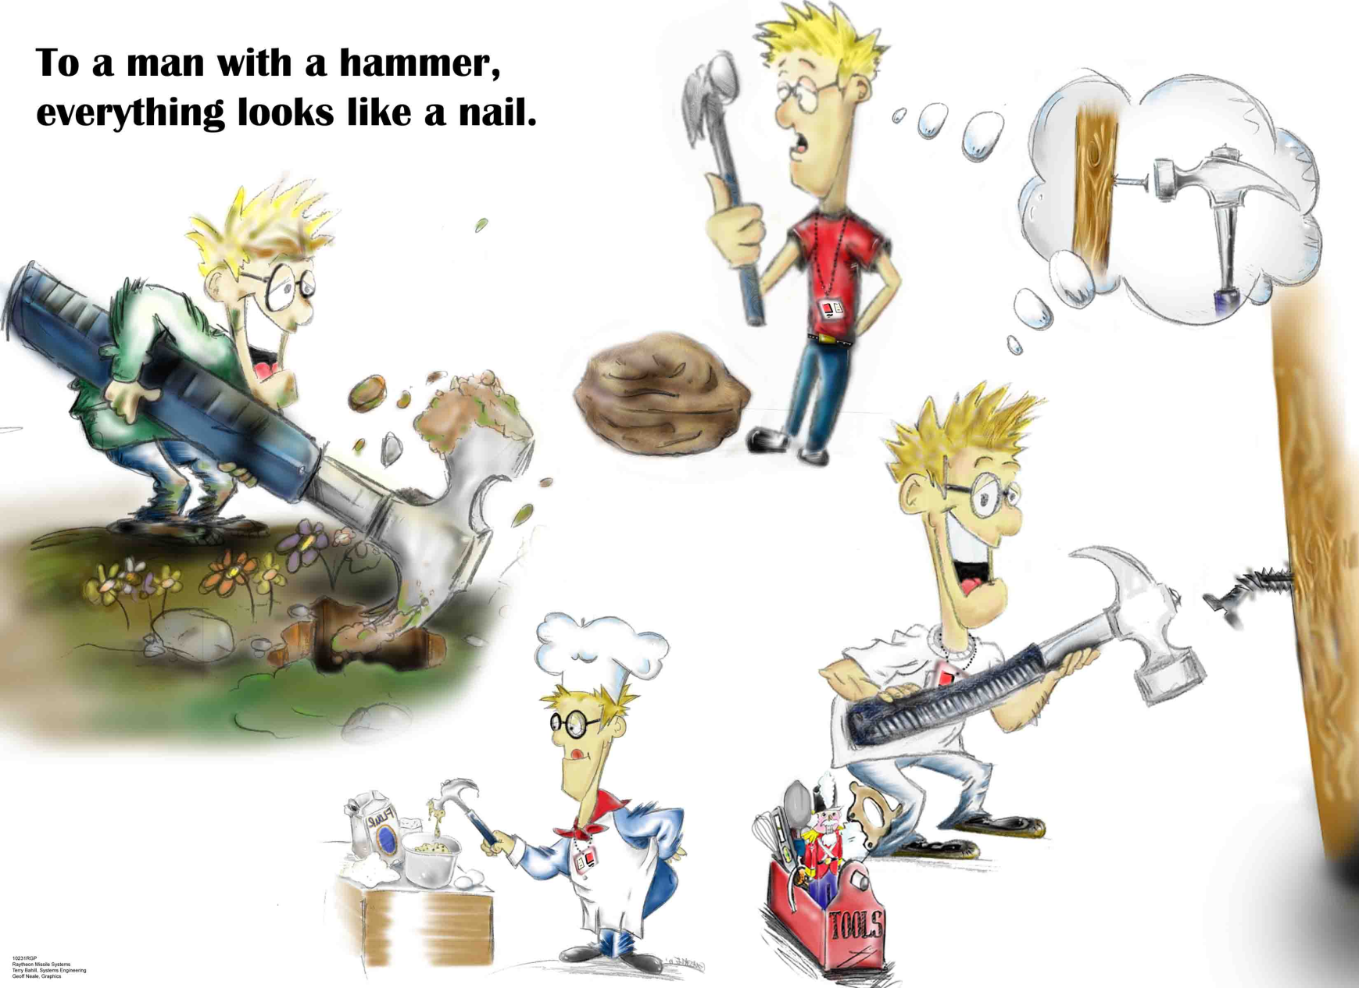
Representation should match system characteristics
Image source: Terry Bahill (http://www.sie.arizona.edu/sysengr/)

Slide 18
Microsimulation
In the social sciences, a microsimulation model is a computer program that mimics the operation of government programs and demographic processes on individual ("micro") members of a population—people, households, or businesses, for example.
Urban Institute Microsimulation
https://www.urban.org/research/data-methods/data-analysis/quantitative-data-analysis/microsimulation

Slide 19
Microsimulations replicate detailed individuals
Individuals may be people, households, firms
Large number of attribute
Often based on Census data, so can include income, age, household structure, education, location, health status
Static microsimulation
Applies some proposed policy to each individual
Dynamic microsimulation
Steps through time and applies probabilities of events occurring based on the detailed profile
Individuals change states as those probabilities are realised
Get married, have children, change jobs, retire, die…
Not a simulation in our sense as no process to be modelled

Slide 20
Example of state changes (disease progression)
State transitions for each individual
Healthy
At Risk
At Serious Risk
Died
Hypothetical population over time
Time 1
Time 2
Time 3

Slide 21
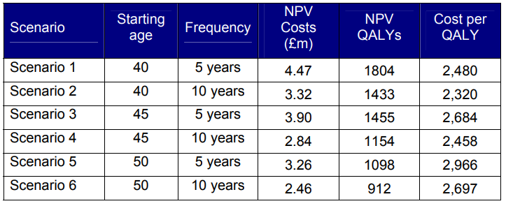
Example: cost effectiveness of a health technology Screening programmes, whether to fund a drug or procedure
Implementation options vary eligible age and how often
QALY is quality adjusted life year
Largest benefit
Only slightly more
cost-effective for
much less benefit
Department of Health (2008), Economic Modelling for Vascular Checks, Table 10
https://webarchive.nationalarchives.gov.uk/ukgwa/20130107105354/http://www.dh.gov.uk/prod_consum_dh/groups/dh_digitalassets/@dh/@en/documents/digitalasset/dh_085917.pdf

Slide 22
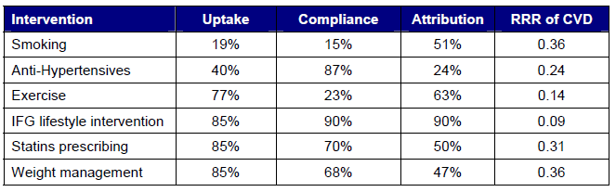
Projected outcomes rely on detailed assumptions
Of those attending health checks and referred to smoking cessation, only 19% of referred people start the intervention and only 15% of those actually stop smoking
Quitting smoking reduces the risk of developing a cardio-vascular disease to 36% of previous level
Department of Health (2008), Economic Modelling for Vascular Checks, Table B1
https://webarchive.nationalarchives.gov.uk/ukgwa/20130107105354/http://www.dh.gov.uk/prod_consum_dh/groups/dh_digitalassets/@dh/@en/documents/digitalasset/dh_085917.pdf

Slide 23
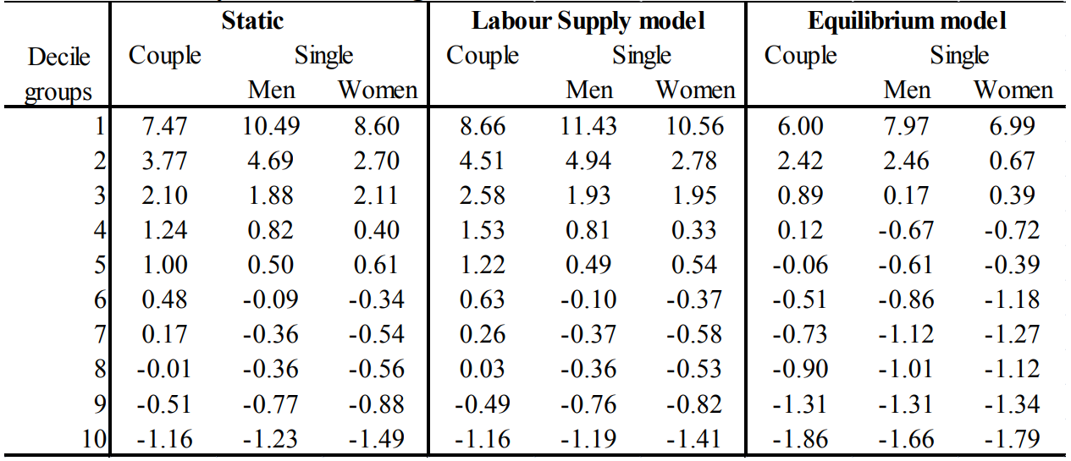
Emphasise distribution impact of policy options (equity)
Microsimulations can calculate the aggregate effect for different subpopulations by summing the effect on individuals within those subpopulation
Example: Simulate a property tax used to fund tax credits for low earners
Sizeable increase in disposable income
Little to no change in disposable income
Minor decrease in disposable income
Moscarola et al (2020). Shifting taxes from labour to property. A simulation under labour market equilibrium. doi: 10.1016/j.jpolmod.2019.07.002

Slide 24
Microsimulations are very detailed
Microsimulations are sensitive to model assumptions
If assumptions are not grounded in good knowledge then the model will have poor validity
Assumptions include the initial states: need detailed knowledge of current state of the system being simulated
Effect of assumptions can be estimated with sensitivity analysis
Perturb the values and simulate again
Even good models will be inaccurate in the long-term
Existing knowledge may not capture all relevant factors
Systems and conditions may change so the model transitions are no longer appropriate
Each simulated individual has detailed state information
Demographic
Health status
Financial information
Each transition probability incorporates relevant state information
Is the change in risk when a woman stops smoking at age 40 the same as for a man at age 80?

Slide 25

Microsimulations do not model complexity
Microsimulation treats cases as independent units
Cases do not interact with one another in the system
Cases do not influence the system, but can respond to the system
Projected outcomes are simply aggregated individual probabilistic paths
More like Weaver’s systems of disorganised complexity than organised complexity
They are used to project policy impacts, but… do NOT help to understand social phenomena

Slide 26
Agent-based modelling
Building
[ABM] … is a computational method that enables a researcher to create, analyse, and experiment with models composed of agents that interact within an environment
Gilbert N (2008). Agent-Based Models. Sage Publications.

Slide 27


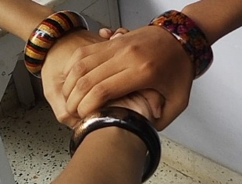




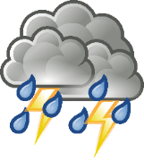

Personal and environmental factors influence a decision
[ABM] … is a computational method that enables a researcher to create, analyse, and experiment with models composed of agents that interact within an environment
OR
Attitude
Habit

Slide 28




Process of multiple decisions
[ABM] … is a computational method that enables a researcher to create, analyse, and experiment with models composed of agents that interact within an environment
X
X
X
X
X
New decision each day
Situation changes (eg weather)
Previous day’s decision, and the effect of that decision, is part of the new information

Slide 29


Simulated decisions to see what happens if …
[ABM] … is a computational method that enables a researcher to create, analyse, and experiment with models composed of agents that interact within an environment
what if…?

Slide 30
ABM as model of process in a complex system
Agent-centric thinking
I, the agent, have certain characteristics and beliefs of my own as well as information about the world around me, and therefore will decide on some action
Process perspective
Series of actions and consequences
What features are therefore relevant?
Personal characteristics that affect agent’s choice
Physical and social environment factors that affect agent’s choice
Rule(s) to combine features and select action
Impact of that action on self and environment

Slide 31
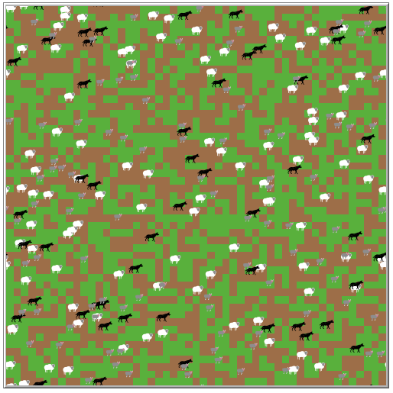
ABMs represent the mechanisms of a social process
Modelled mechanism
Environment has patches with or without grass
Sheep move randomly and eat grass on same patch
Wolves move randomly and eat sheep on same patch
Sheep and wolves die if they do not eat regularly
Sheep and wolves spawn offspring when well fed
Grass regrows over time
Population cycles are not directly coded but emerge from conditions of food surplus and scarcity
NetLogo model library
Wolf-Sheep predator prey

Slide 32
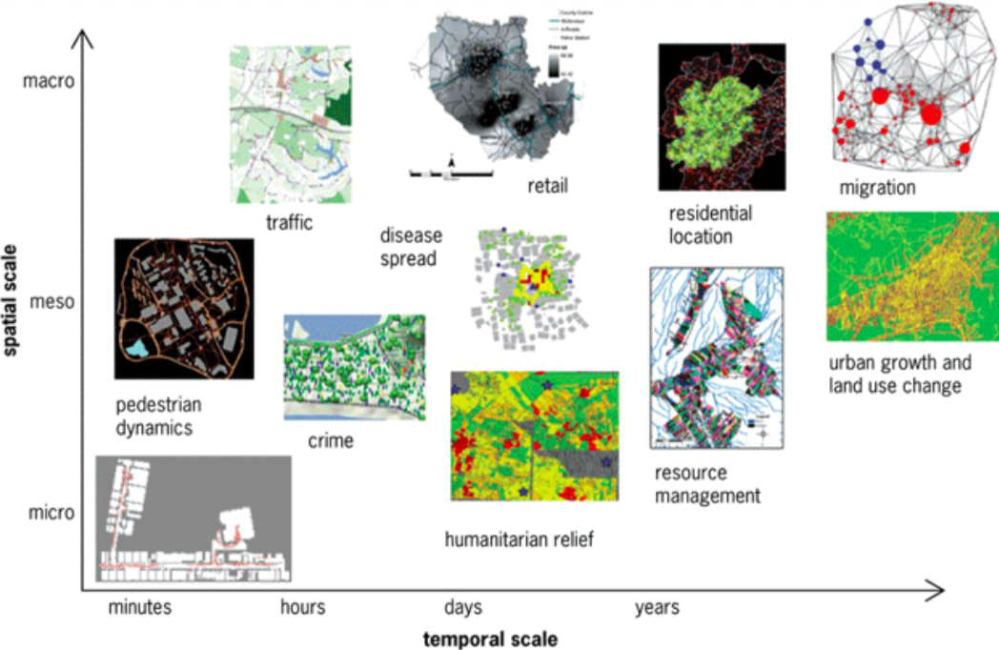
Models of all sorts of social processes
Crooks, Malleson, Manley, Heppenstall (2019). Agent-Based Modelling & Geographical Information Systems, Fig 7.1
doi:10.4135/9781529793543

Slide 33
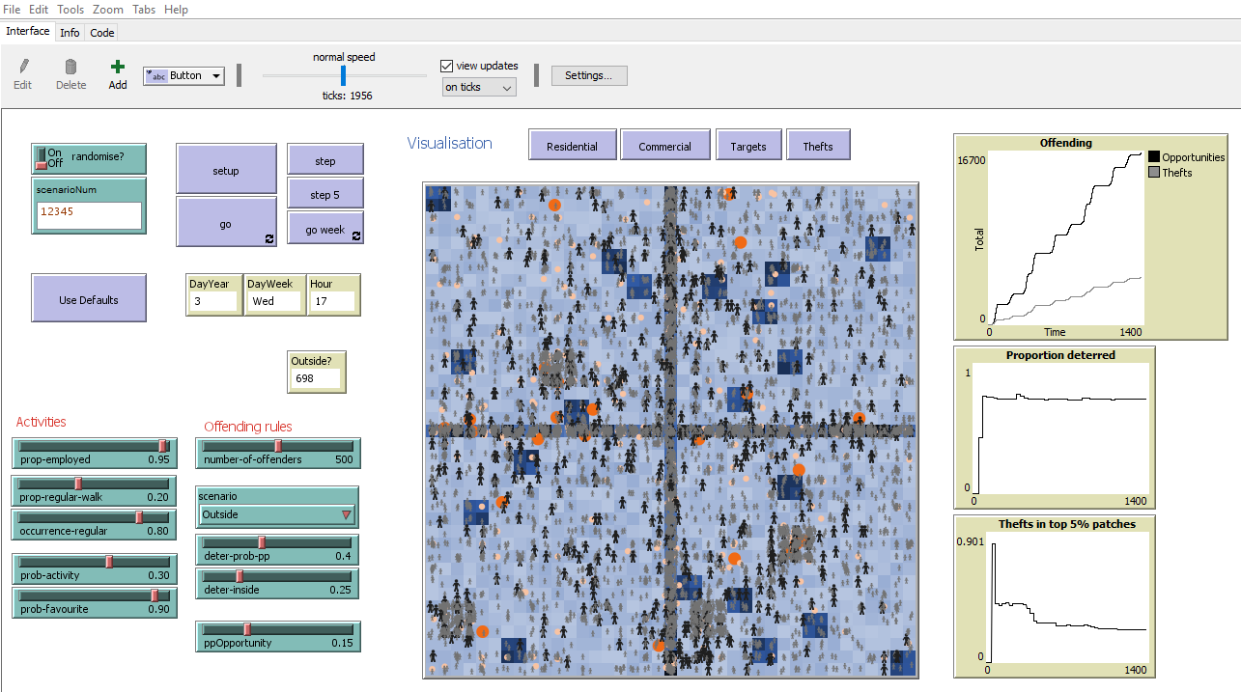
Elements of an ABM
Example model: Guardianship
What’s in the model?
Agents
Environment
Behaviour
Interactions
Time
Groff E, Badham J. ‘Examining guardianship against theft’ in Gerritsen C, Elffers H (ed) Agent-based Modelling for Criminological Theory Testing.

Slide 34
Agents
Concept
Guardianship model
The individuals being simulated
Doing the process
Typically people (in social science)
Also households or firms
Could be
Organisations: government, NGOs, countries
Concepts: eg social practices
Animals, cells, vehicles
People
Attributes include:
Potential offender (or not)
Work status
Preferred activities

Slide 35
Environment
Concept
Guardianship model
Typically a two-dimensional space
Can be 3D if altitude is relevant
Made up of patches or cells in a grid
Patches have attributes
Location: provide distance, direction
Resources: such as grass
Grid with residential and business areas
Agents have home and workplace

Slide 36
Time
Concept
Guardianship model
Time passes: simulation, not just a model
Discrete timesteps or ticks
Each tick represents a unit of real world time
Agents make decisions each tick
Key consideration is duration represented by tick
Relevant time scale for decisions
Epidemic may be 1 day
Housing market may be 3 months
Simulation runs for many ticks
Time step is two minutes
Schedule of activities
Commute at similar times each day
Selection of short activities in the evening
Selection of long activities on the weekend

Slide 37













Activity examples
25% of commuters use public transport
≈5 min
≈5 min
15-30 min
≈5 min
Short activities: 30% weekday evening, weekend morning
Distance 8-15
32-60 min (return)
≤ 10 min
15-30 min
≤ 10 min
Long activities: 30% weekend afternoon
0.5-3.5 hr
≈5 min
25-45 min
≈5 min

Slide 38
Behaviour
Concept
Guardianship model
Rules that determine agent action
Each agent makes independent decision (autonomy)
Action influenced by own situation and environment
Action impacts on local environment
Crime requires convergence of
Motivated offender
Agent attribute
Suitable target
Opportunistic, based on number of people on patch
Absence of guardian

Slide 39
Interactions
Concept
Guardianship model
Agent behaviour influenced by situation
Indirect interaction
Other agents affect the environment
Example: resources used so not available
Direct interaction
Agent decision depends involves others
Example: buyer needs a seller
Agent decision influenced by others
Example: social norm to wear masks
For offenders
Theft only possible if others present
If too many others, deterred
Future work
Agents become familiar with places and each other
Familiarity leads to confidence to steal or to intervene

Slide 40









Opportunity leads to either theft or deterrence
Offender perspective of guardianship: deterred by sufficient observable guardians
Opportunity: base + amount per person present
YES
$$P\left(deterrence\right)={1−\left(1 −d\right)}^{G}$$
d is deterrence per guardian
G is number of guardians
Scenario | Value of G
None | 0
Outside | Outside people
Available 0.1 | Outside people + 0.1 x Inside
Available 0.25 | Outside people + 0.25 x Inside
NO

Slide 41
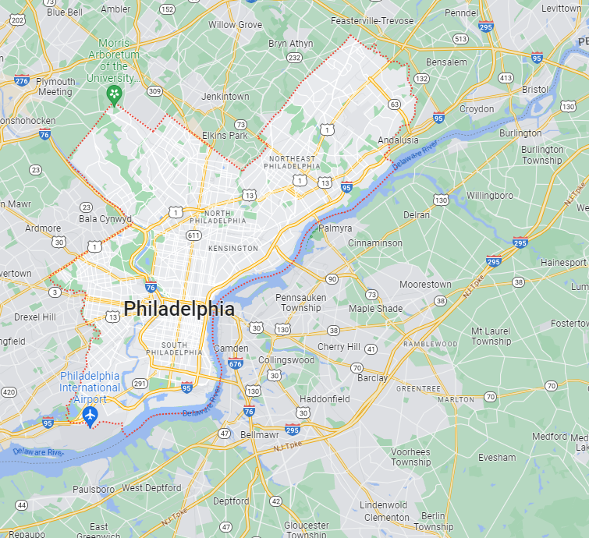
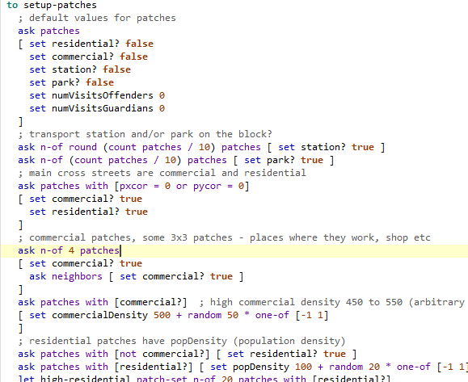
Traps for the novice ABM builder
Arbitrary rather than abstract
The simulation rules must be recognisable simplifications of the mechanisms in the real world
Excessively complicated design
Don’t include attributes if they don’t change behaviour
ABMs with too many mechanisms are difficult to interpret as cannot identify the mechanism that generated the result
Lack of coding skills
ABMs require specialist skills to produce
Experience in computer programming is required

Slide 42

Agent-based modelling
Using

Slide 43
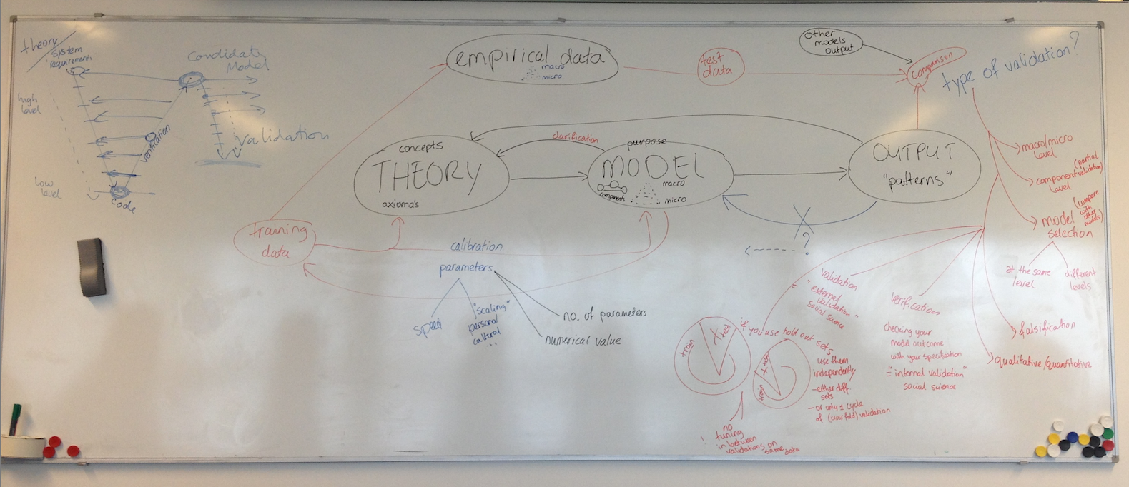
Process of ABM in research is messy
Photo courtesy of Dr Corinna Elsenbroich

Slide 44
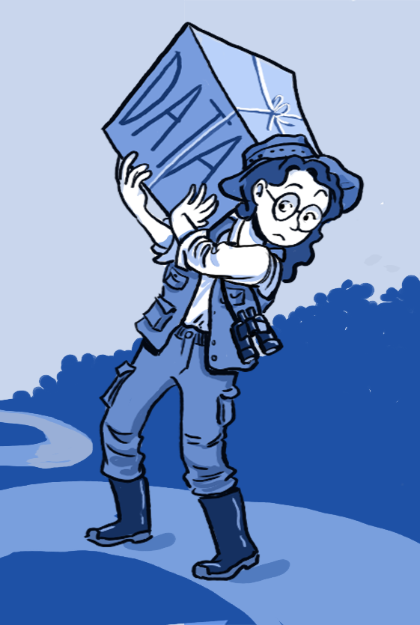
Parameterisation and calibration
Scenario defined by a particular set of parameter values
Parameterisation: select values for parameters
Some parameters may have target system equivalents (eg disease state duration), so value taken from real world
Parameter sweeping explores model behaviour
Calibration: select parameter values so as to generate most realistic model output
Matching patterns, not necessarily some measure
Part of validity assessment

Slide 45
Verification and validation
Verification: Is the model ‘right’?
Is it doing what we say/think it is doing?
Syntax errors are easy to find, throw error messages
Logic errors are difficult, particular where complexity
Critical to build and test incrementally
Validation: Is it the right model?
Replication: model output matches historical data
Prediction: model output matches target system data collected later
Structural: model reproduces target system behaviour using the same mechanisms as occur in the target system

Slide 46
Scenarios are experiments with the ABM
Experiments for various purpose
Research question
what relationship is hypothesised?
implications of the implemented theory (process)?
Understand the limitations of the model
sensitivity and uncertainty analysis
Effect of different scenarios
Common: effect of inputs on output(s)
Input is parameter value (number) or category (scenario)
Output is pattern or value
Some parameters are control (fixed) variables

Slide 47
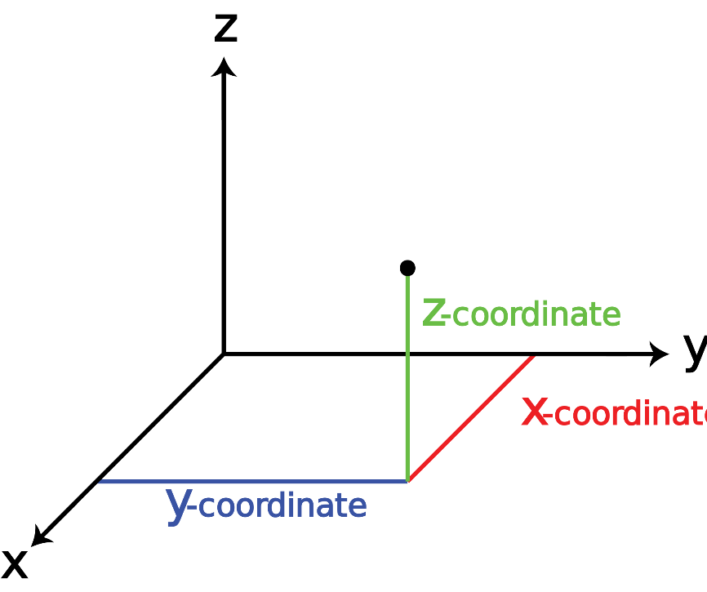
Curse of dimensionality
Each parameter
multiple settings
each category
numeric value ranges
multiplies the number of simulations
eg If 3 inputs have 4 possible values each, 4x4x4 = 64 combinations
gets out of control VERY easily
Parameter space
term used to denote the combination of all input variable values
one dimension for each variable

Slide 48
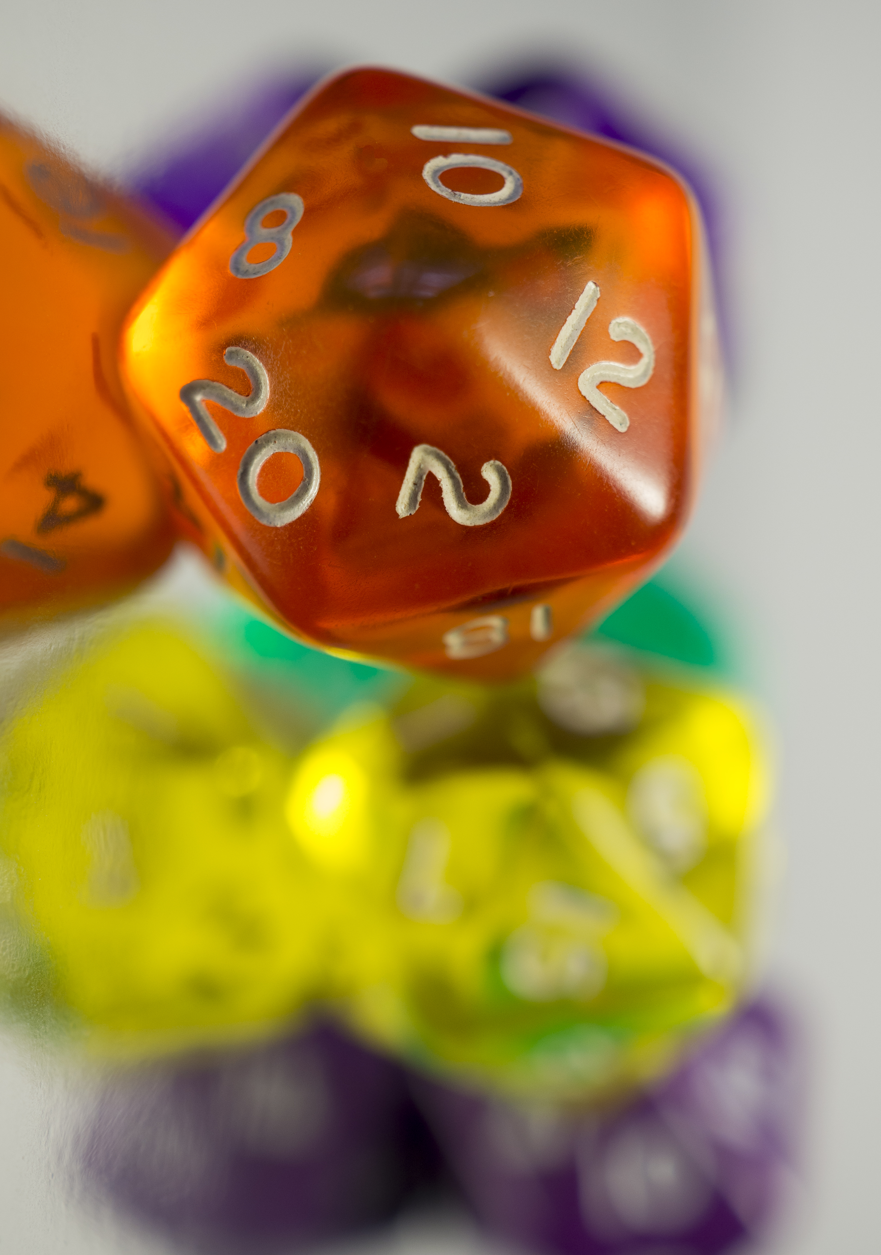
How many simulations?
Most ABMs include random elements
Starting configuration
Order in which agents make their decisions
and affect the environment of other agents
Consequence of agent-agent interaction
such as whether information is transmitted
Movement direction and/or distance
This means need multiple simulations for each scenario
No good answer for how many
Statistical significance is meaningless, arbitrarily increase number
May do preliminary experiments to assess variability

Slide 49
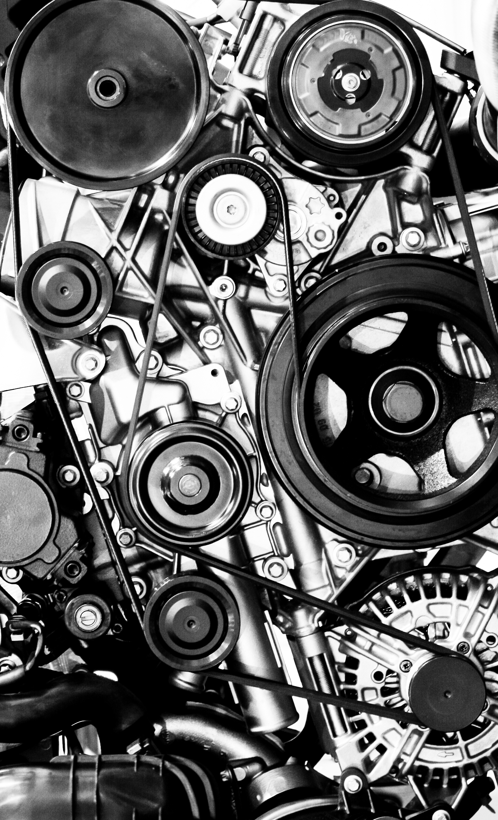
ABMs used to test or generate theories
Test whether the purported mechanisms are able to generate the social phenomenon of interest
Not proof that the theory is correct, just that it is a plausible explanation
Rule-based simulations allow us to see mechanisms and their effects in action and by changing parameters allow us to explore how they work in different ways
Exploring ideas is a function of ABMs but such exploration should be systematic and theoretically informed
Unexpected outcomes may stimulate further hypotheses

Slide 50
Scenarios
Concept
Guardianship model
These are the experiments: what if…
Policy scenarios
Effect of different implementations
Theory scenarios
Under what parameters is the mechanism a plausible generator of phenomenon?
Sensitivity scenarios
Effect of unknowns in data or theory
Theory scenarios
Effect of different levels of intervention
Which agents are considered for deterrence
Future work
Effect of familiarity

Slide 51
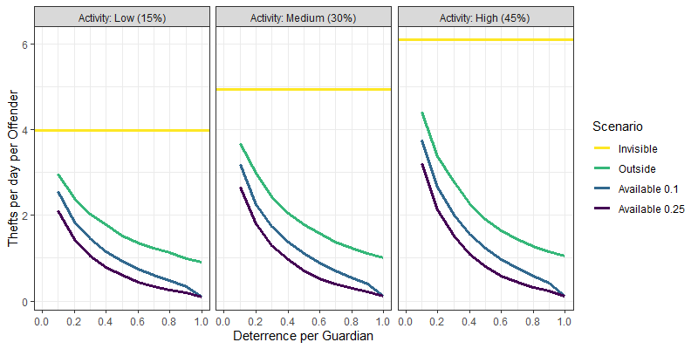
Results (guardianship model): Theft levels
Increased vigilance reduces thefts
No surprise there
Greater activity increases thefts
Less obvious than it may appear
Opportunities increase faster than guardianship as other people present

Slide 52
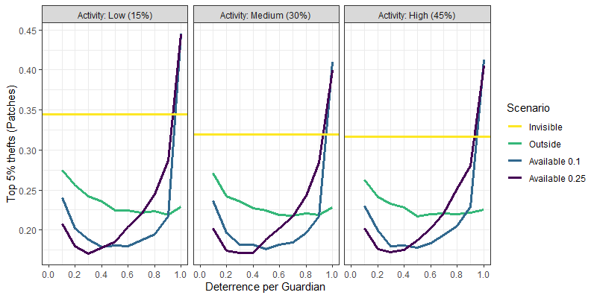
Results (guardianship model): Theft distribution
At low deterrence per guardian
Thefts more widespread as deterrence increases
Thefts more spatially concentrated as guardians added
Opposite patterns at high deterrence per guardian
Activity level has minimal effect
Not at all obvious

Slide 53
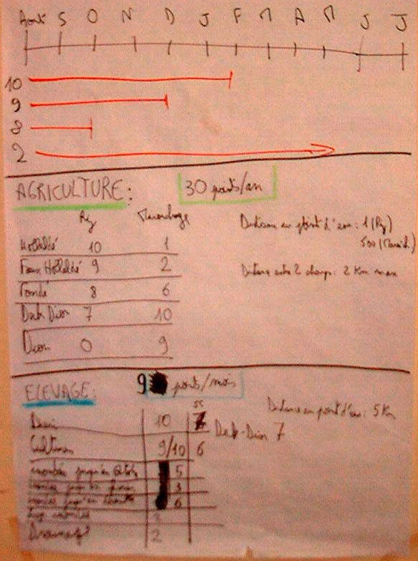
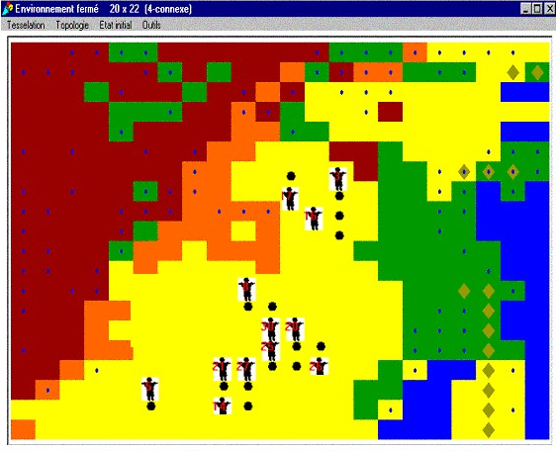
ABMs as tools for discussion
Particularly in participatory modelling settings
Stakeholders co-design the model
Design process elicits knowledge and competing perceptions
Model provides shared understanding
Playing model moves from entrenched positions
Example: G’nith land use
Can criticise model instead of each other
D’Aquino, Le Page, Bousquet, Bah (2003). Using Self-designed Role-playing Games and a Multi-agent System to Empower a Local Decision-making Process for Land Use Management. JASSS 6(3) 5

Slide 54

Simulation
(wrap up)

Slide 55
Two common simulation methods in social research
Microsimulation and Agent-Based Modelling both simulate individuals stepping through time
Microsimulation focus is state transitions
Detailed state descriptions
Individual transitions are independent
ABM focus is theoretical mechanisms of change
Relatively simple states
Agents interact with each other and environment

Slide 56
Characteristics of ABMs
Simulation
Models a series of actions and their effects
Actions are taken by autonomous individuals (agents)
What are my choices?
What do I need to know?
What do I do?
Heterogeneity
Same agent, different situation → potentially different action
Different agents, same situation → potentially different actions
Interaction
Agents can perceive other agents
Agent actions affect the situation of others and their future self

Slide 57
Fundamentals of Agent-Based Modelling
ABMs focus on the macro-consequence of micro-actions
You need to understand the system that you wish to model
What process are you modelling?
How do people make decisions that enact the process of interest?
You need to have answers, or at least a plan to get them
ABMs represent the target system but are not the system itself
Understand whether mechanisms are plausible explanation
Cannot tell us what happened in any specific case; they cannot replace empirical study

Slide 58
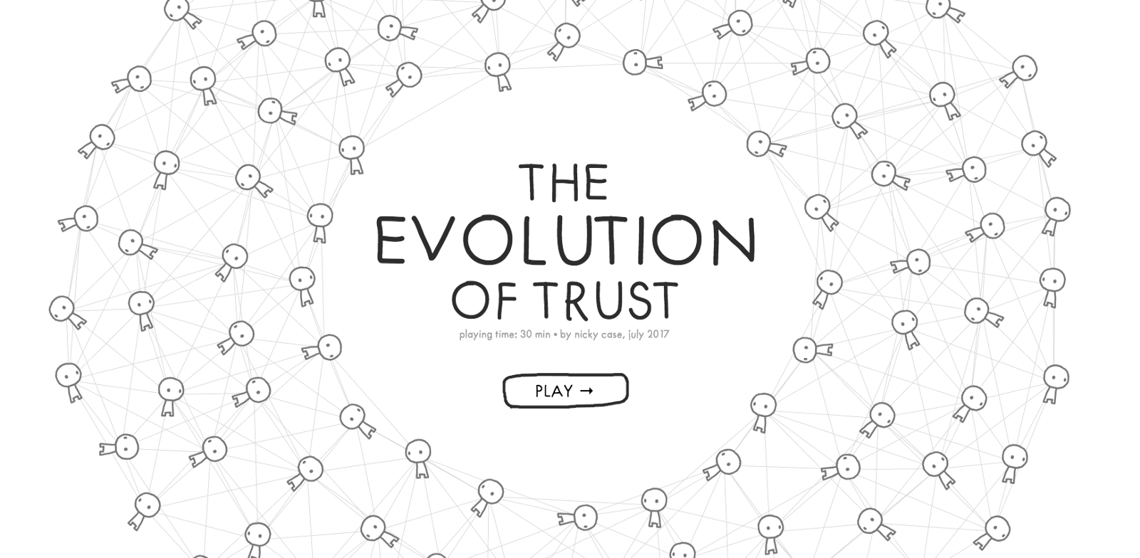
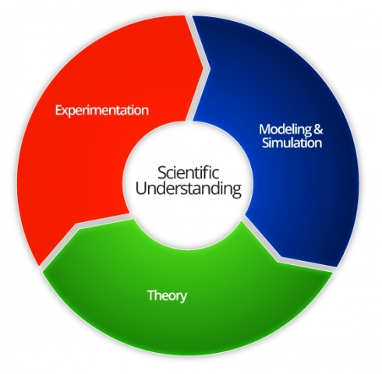

Types of research questions
Simulations can be used to extrapolate plausible future outcomes of complex systems…
…or to produce theories and hypotheses for empirical examination
…to test theories and hypotheses derived from empirical data

Slide 59
Justified Stories: formalising “what if?”
Stories
Sequence of events (dynamic)
Coherent
Internally consistent
Justified
Represents knowledge about the world
Multiple sources: data, theory, expert opinion
Externally consistent
plausible, given knowledge

Slide 60

Models assist insight
Tool for thinking: Model captures some theory of process and allows us to examine the implications of that theory

Slide 61

Next session: Agent-Based Modelling Workshop
Work with a simple NetLogo model
Conformity with majority vote
Exercises
Understand the existing model
Experiment with the model
Extend the model
NetLogo: Specialist ABM software
Download from https://ccl.northwestern.edu/netlogo
Start model is on Blackboard Ultra

